Slide 1




All Saints’ CofE Academy
SEND Information Report
This is All Saints’ CofE Academy’s SEND information report. This report has all the information that you will need to participate fully in the education of your child and should be read together with our SEND policy.
Policies | All Saints Church of England Academy

Slide 2
Our Vision
What are the different kinds of SEND the academy caters for ?
Who are the SEND staff at the academy ?
What is the local offer ?
If I am concerned about my child, what should I do?
Who should I talk to if I need to know anything about my child’s SEND?
If the academy are concerned about my child, what will they do ?
How will I know if my child is making progress ?
How will my child’s voice be heard ?
Which services does the academy use to support children with SEND ?
How will my child be supported when they move to another year group ?
How will teaching be adapted for my child ?
What resources are available ?
What is the pastoral, medical and social support available in the school to ensure my child’s well-being?
What support is there for me as a parent ?
What training is available to staff to support SEND ?
What extra curricular activities will be available for my child?
How does the academy support children who have SEND and are Looked after ?
How are complaints dealt with ?

Slide 3

Our Vision
We are a fully inclusive, mainstream academy, that belongs to the Diocese of Coventry Multi Academy Trust. The Core Mission of the Diocese of Coventry Multi Academy Trust is to build a better future for all within our Academies who in turn will positively impact their communities.
Together, pursuing ‘life in all its fullness’ (based on John 10, 10)
Within a Christian framework at All Saints’ C of E Academy we aim to challenge and support all pupils to enable them to develop their talents and achieve their potential. All individuals are valued irrespective of ability, race, gender, culture or faith.
We aim to provide excellent teaching and stimulating learning experiences across a broad and balanced curriculum, within a happy, caring, inclusive and safe environment.
We aim to enable each child to develop the personal and social skills necessary for them to become independent, responsible, active participants in their community through partnerships with home, our parish churches, local neighbourhoods and the wider community.

Slide 4

What are the different kinds of SEND the academy caters for ?
The needs of a child with SEND will fall under one or more of these four areas, as outlined in the SEND Code of Practice:
Communication and interaction
Cognition and learning
Social, emotional and mental health difficulties
Sensory and/or physical needs

Slide 5

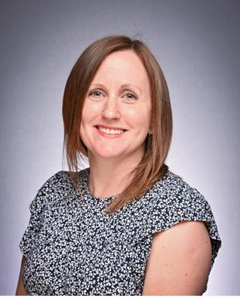
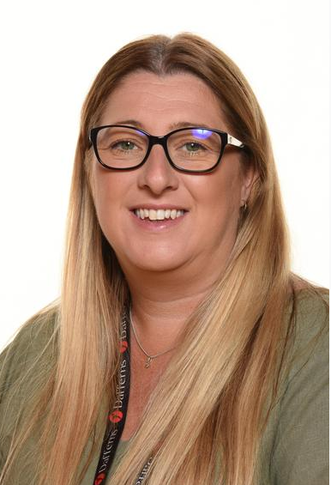
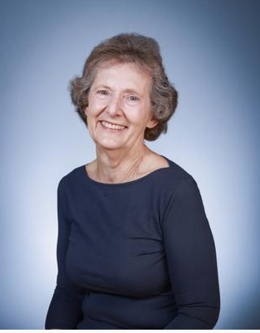
Who are our SEND staff at the academy ?
SENDCo: Miss Kelly Lucking
AGC Members responsible for SEND:
Lucy Hatton Lesley Tacon
At All Saints’ CofE Academy, all of our staff are teachers of SEND and as a result all receive training on supporting pupils with SEND .

Slide 6

What is the Local Offer ?
Local Authorities and schools are required to publish and keep under review information about services they expect to be available for the children and young people with special educational needs and disabilities (SEND). This is the ‘Local Offer’ and is available through:
https://www.warwickshire.gov.uk/sendlocaloffer

Slide 7

If I am concerned about my child, what should I do?
Please refer to the class teacher in the first instance.
If you need further support having spoken with the class teacher, please then contact the office to arrange an appointment with Miss Kelly Lucking, SENDCo.
Children are sometimes identified as having SEND before they start at All Saints’ CofE Academy. We visit children in their Nursery settings/ Infant schools and speak to staff about any difficulties children may be experiencing, strategies that are currently effective in supporting them and whether there are any agencies involved. The SENDCo is available at transition events for parents to ask questions and share concerns. If there are complex needs, sometimes a multi-agency meeting may be held in order to share information and ensure that provision is in place before the child starts school. We request that records are passed to us from Early years settings/ Infant schools before a child starts in Reception. Sharing information fully with Early Years Settings/ Infant schools and at transition meetings to raise any questions you have at this early stage helps to ensure effective support can be provided as early as possible.

Slide 8

Who should I talk to if I need to know anything about my child’s SEND?
At All Saints’ CofE Academy, we parents who have concerns about their child’s special educational needs can make an appointment for a meeting via the school office. We welcome telephone calls to arrange appointments to meet with Miss Kelly Lucking, SENDCo, where any concerns that you may have in relation to your child can be discussed fully.

Slide 9
If the academy are concerned about my child, what will they do?
As children begin school with us, assessments are carried out. Staff check the progress of the children carefully. At pupil progress meetings with the Head Teacher/SENDCo, children who are not making good progress will be highlighted by staff, and strategies and intervention can then be discussed. It is at this point that staff start to create a portfolio of evidence to show the impact of interventions that have taken place and whether additional support is needed.
As children move through the school, this tracking of progress continues, and teachers discuss any children for whom they have concerns with the SENDCo, completing an Initial Concern form to collate evidence, including conversations with parents. When staff have tried class-based interventions, the SENDCo will then carry out an observation of the child and will discuss further strategies or interventions. This is part of our Graduated response.
Lack of progress despite Adaptive Teaching.
Initial Concern form completed by class teacher compiling evidence:
Background information, Assessment data, strategies tried, observations, discussions with parents.
SENDCo observes child and meets parents/carers. Decision made as to whether an IEP is appropriate. Child added to SEND register if agreed with all parties. This is continually reviewed .

Slide 10

The SENDCo will also liaise with previous schools, where children transfer to All Saints’ CofE Academy during their primary education and additional needs have been identified.
Advice from outside agencies may be sought, only after a period of intervention has been unsuccessful in allowing the child to bridge any gaps in their learning and get back on track with their learning targets. At this point further assessments can be carried out.

Slide 11
How do you know if my child is making progress?
Progress is tracked and discussed with the Head Teacher and SENDCo at termly pupil progress meetings. Interventions are monitored by the SENDCo, and assessment is carried out prior to, and following, the intervention in order to measure progress. The SENDCo tracks the progress of children with SEND more closely and uses information about this progress to map provision across the school. Parents are informed of their child’s progress via IEP Reviews and meetings are offered with parents to discuss reviews in more detail.

Slide 12
How will my child’s voice be heard ?
Listening to what your child has to say is key to their own development and progress, and to our understanding of how we can best offer support. We involve your child in discussions around what might help them in terms of their learning and wellbeing and in reviewing their progress. We also collect pupil voice regularly to inform next steps, and children can express their views as part of reviews of IEPs and EHCPs.

Slide 13

Which services does the academy use to support children with SEND ?
School arranges access to a range of services on a contractual/referral basis. These include
Educational Psychologist
Specialist Teaching Service (STS)
Speech and Language Therapy
Occupational therapy
Physiotherapy
Visual Support Service
RISE (Previously CAMHS)
Connect for Health (School nursing service)
CCASS (Children’s Community Autism Support Service).
Neurodevelopment Service

Slide 14

How will you support my child when they move to another year group ?
Pupils visit their new teacher during transition day, which is a whole school event.
For those pupils who need it, enhanced provision happens where the child visits their new classroom and teacher regularly in the second part of the summer term.
Transition booklets are produced for children to have over the summer holiday for use at home.
Staff meet to share what works with your child and to support class handover.

Slide 15

How will teaching be adapted for my child?
Through Quality First Teaching, we ensure that the needs of children with SEND are met.
We provide a graduated response to meeting children’s needs
Any interventions your child receives will be evaluated for impact.
A whole-school provision map ensures that resources and strategies are targeted well to meet pupils’ needs to maximise progress.
As part of children’s IEP (Individual Education Plan),children are set learning targets and these are reviewed. These targets are shared with parents at termly reviews.

Slide 16

What resources are available?
It is the responsibility of the class teacher to set work and develop resources that are well matched to the needs of the children in their class. Wherever possible, children will be supported in the classroom, using a range of interventions. When a child is supported by an outside agency, resources will be provided following their recommendations about how best to meet specific needs.
In some cases, children receive an intervention which is specific to the child and this may take place outside the classroom.

Slide 17

What is the pastoral, medical and social support available in the school to ensure my child’s well-being?
Our school is values driven and underpinned by our Christian faith.
Personal, Social and Health Education (PSHE) is integral to our curriculum and is also taught discretely using the LCP scheme of learning.
The class teacher has overall responsibility for the pastoral, medical and social care of every child in their class and so they should be your first port of call. If further support is required, the class teacher liaises with the SENDCo for further advice and support. This may involve working alongside outside agencies.

Slide 18
What support is there for me as a parent?
Staff value observations from the parents of the children in their care. Class teachers are available to discuss any concerns informally at the end of each school day. Parents/carers are offered the opportunity to discuss their child’s progress with class teachers twice a year at parent consultations and SEND meetings with parents are offered at IEP Review points termly.
A mid year report is sent home and also a final end of year report.
We are here to listen to any concerns you have or to talk through any questions. Please talk to your child’s class teacher in the first instance and contact the school office or email Miss Kelly Lucking, SENDCo, if you’d like to chat things through further (Kelly.lucking@greenleek.covmat.org).
We can signpost you to parent support groups, organisations and workshops.

Slide 19

What training is available to staff supporting SEND?
All staff have safeguarding training.
Our school SENDCo is qualified and is experienced in this field.
All our teachers hold Qualified Teacher status, and they receive training across each academic year. We keep a record of ongoing training.
Some of our staff are trained in specific interventions.
All staff are Team Teach trained.
All staff receive training on how best to support children with SEND.
Our SENDCo works alongside the Head of School to develop a training plan for staff linked to identified areas of need in school and aligns with our provision map.

Slide 20
What extra curricular activities will be available for my child?
Our Equal Opportunities policy promotes involvement of all our learners in all aspects of the curriculum including activities outside the classroom. Where there are concerns for safety and access, a personalised risk assessment is carried out to consider if reasonable adjustments can be met to meet any additional needs. If appropriate, parents/carers will be consulted and involved in planning.

Slide 21
How does the academy support children who have SEND and are Looked after?
Miss Kelly Lucking, SENDCo, is also our Designated Teacher for children who are Looked After or Previously Looked After. She works with Warwickshire Virtual School to ensure children who are Looked After have their needs met via additional support plans. Where a child also has SEND, the additional support plans will have targets in line with IEP targets.

Slide 22
How are complaints dealt with?
Complaints are dealt with in line with the school Complaints Policy which is available on the school website or from the School Office.
Trust Wide Policies | All Saints Church of England Academy

